Slide 1
FlappyBird in React-Native Using React Native Game Engine and Matter js
GROUP MEMBERS:
ALI ABID CHAUHDARY.
Muhammad Tayyab
Hafiz Yaseen

Slide 2
Introduction
Flappy Bird is one of those games that most people know about, even if they have never played it. The game has simple physics. There is a bird and pipes. The idea is to fly the bird across the pipes. On collision with the pipes the game is over.
Project Motivation
Our main motivation was to answer a simple question:
“CAN REACT-NATIVE BE USED TO BUILD ANDROID GAMES?”
The answer was “Yes!”.
We found out that the following frameworks can be used to build games in react native:
React Native Game Engine: A lightweight Gaming Architecture
Matter js: A 2D physics Engine for the web
We are using both of these frameworks to build our game.

Slide 3
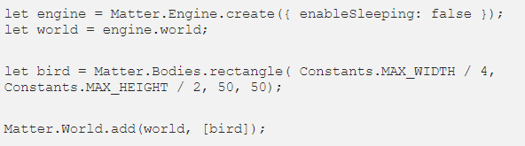
Entities of the Game World
Our Game World has the following main entities:
Bird: Handled in Bird.js
Pipes: handled in pipes.ks
Floor: handled in floor.js
Now we will go through all these entities one by one and the gaming physics involved. Our gaming physics is handled in our physics.js component.
But first we have to setup our game world. In our app js it is done as

Slide 4
Bird
The bird graphic is a set of 120x99 transparent png files. However, our original bird, represented by a rectangle is a 50x50 point square — it will be distorted if we just applied the image.Our bird will fly on touch, this is done using the game engine’s apply force method. So we are applying an animation effect Our bird entity has the following functions:
Bird Animation:
In order to give our bird a flying effect, we are rotating our bird graphic between
a set of three images in our bird.js file
Bird Gravity
The gravity effect of the bird is achieved using matter js gravity component here value of y –component is defined as 1.2. So on every tap the bird will start to descend.
Bird Collsion
The collision is detected using React native gaming engine’s collisionStart() method.
When ever a collsion is detected, we are freezing the game state and dispatching the game over message on the screen

Slide 5
Pipes
Pipes are defined in the pipe.js, Our pipes are randomly generated of random heidghts. For pipes we have two components:
Pipe Component (For The Core Of the Pipe)
PipeTop (For the top of the Pipe)
Implementation:
We define a pipes = 0 variable to keep track of the number of pipe(set)s in our world.
We expose a resetPipeCount function to our main world to reset the active pipes, in case the user dies.
generatePipes generates two sets of heights with a set gap between them.
addPipesAtLocation adds a set of pipe at a given x location to our world and to our entities. It will create the following entities: pipe1, pipe1Top, pipe2, pipe2Top (of course, depending on our pipes variable’s value, the name will change)

Slide 6
Pipes Continued
When the user first taps the screen we add two sets of pipes. One at the end of the 3rd screen, one at the end of the 4th screen
Every entity that starts with the word “pipe” we keep moving to the left by two units on every tick.
On every bottom pipe (even number pipe id) we check if the bird's position has passed the pipe’s position — if so we emit a “score” event
Also on every bottom pipe we check if the given pipe has left the screen. If so we remove the entire pipe set and generate a new one.

Slide 7
Floor and Game Score
Our floor is moving. This gives the illusion that our bird is flying. All we’re doing here is looping through our entities. If the entity name starts with “floor” we move their x position by -2. If the piece of floor moves out of the screen we quickly move it one screen to the right.
Score:
The score is stored in the form of a state. When ever the bird passes through a pipe we are incrementing our score by one. When to increment the score is done through the bird’s position. If the bird is moving and is at the position where pipes are. The score is incremented if the bard covers the whole width of the pipe without any collision.
GameOver:
On collision with the floor or with the pipe. The game is freezed and Gameover message us dispatched.

Slide 8
Individual Contribution
HAFIZ YASEEN
Game world setup
Game physics
Tayyab
Gui
Ali Abid Chauhdary
Error Solving
Game Optimiztion For Android

Slide 9
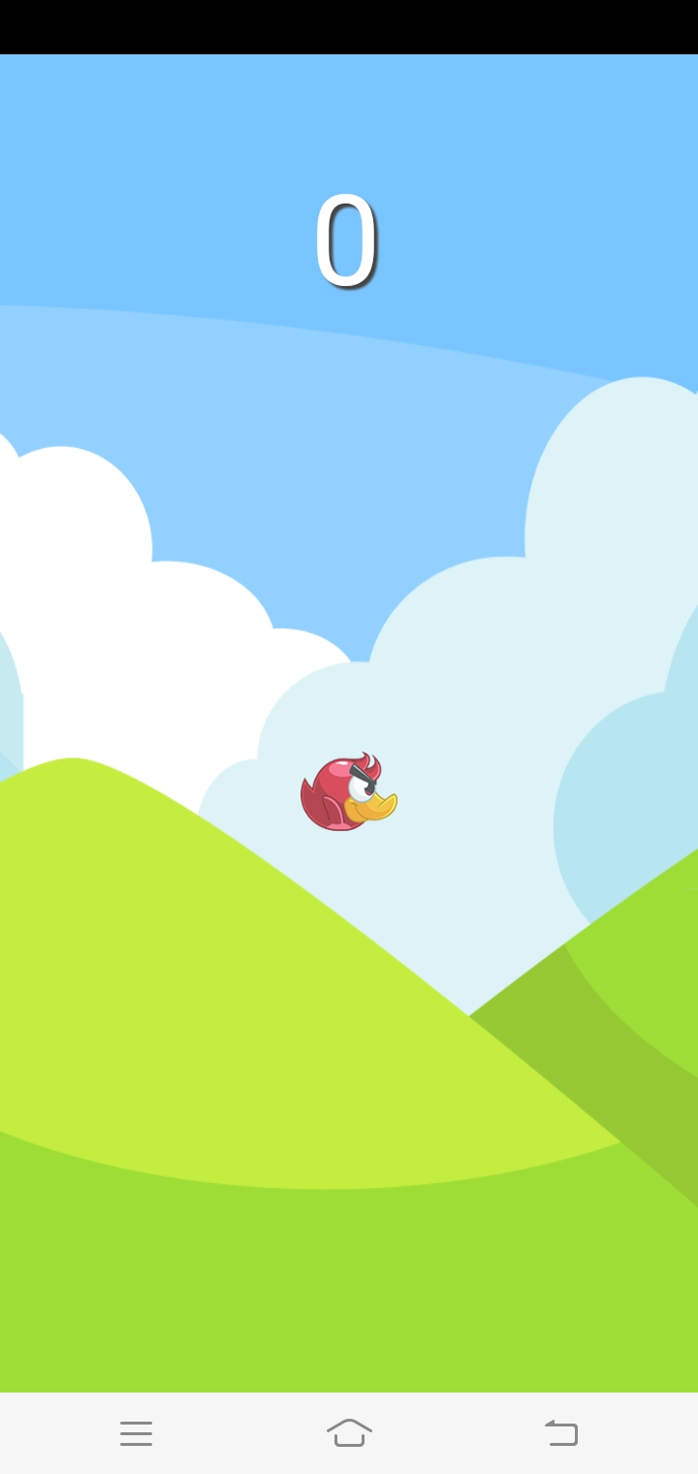
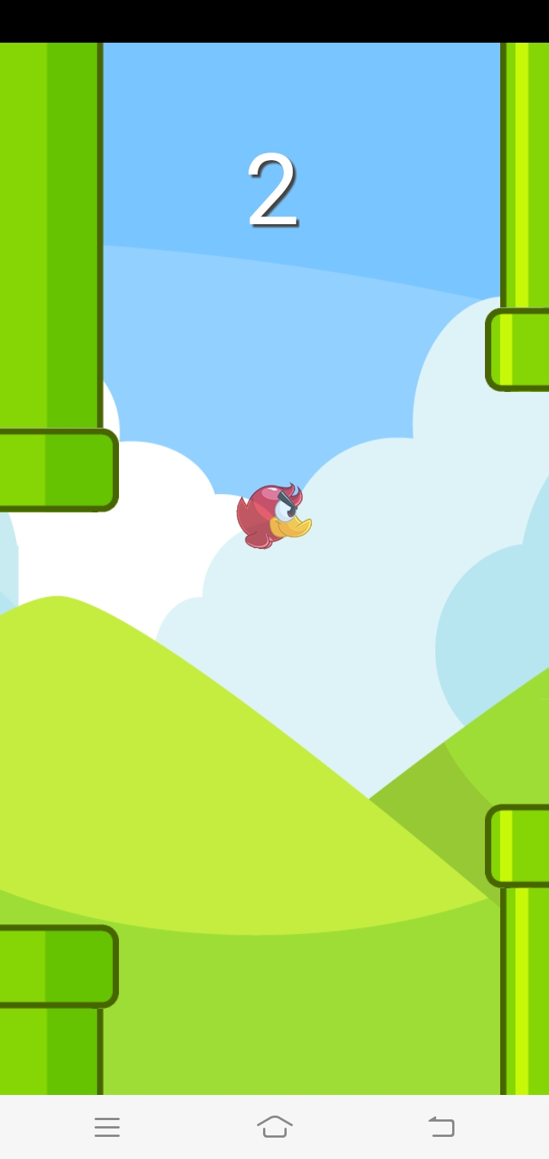
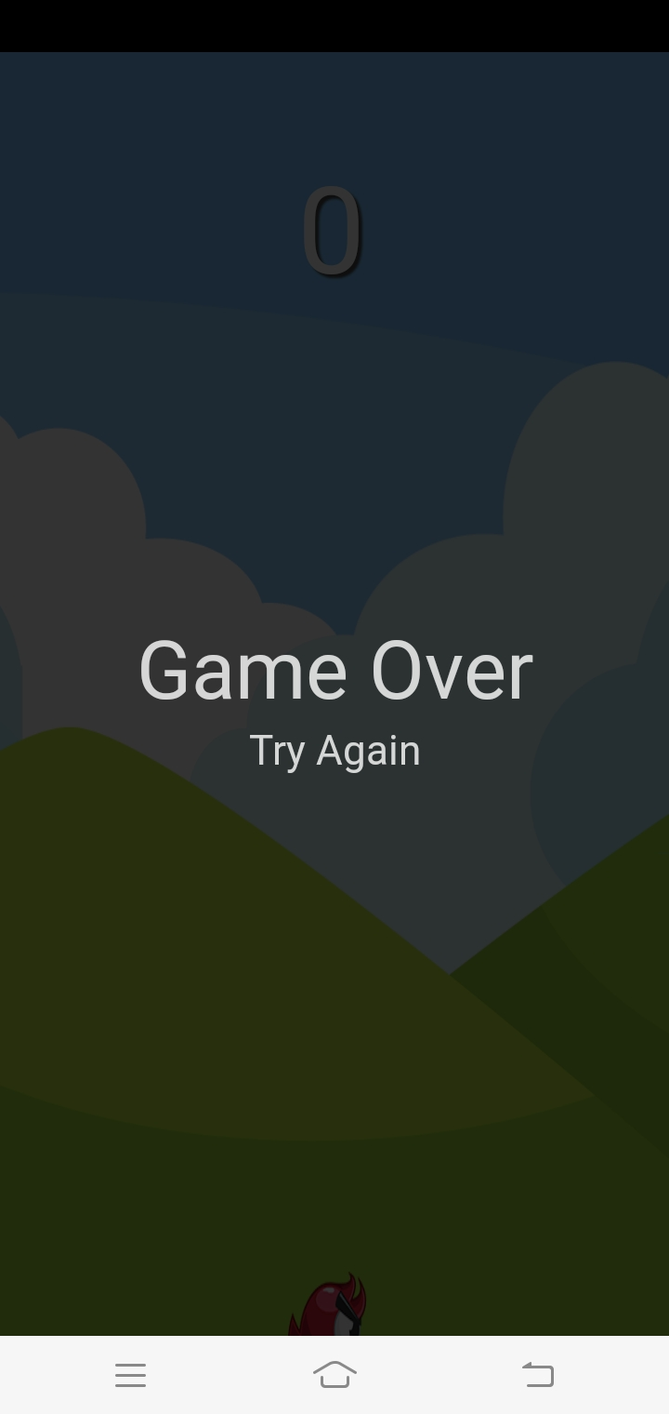
Final Product

